Slide 2
SP3D Hangers and Supports Task

Slide 3
Overview
The Hangers and Supports Task Module is used to model supports/hangers for piping, ducts and trays
A support is an assembly of parts, also called components, which connect together to the supported features, and to the supporting structure
Can place two types of supports, Standard Supports and Designed Supports
Hangers and supports are dependent on both the supporting object and the supported object
Place the supporting and supported objects before placing any hangers or supports
Tools are provided for automatic support drawing creation

Slide 4
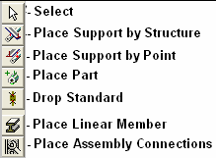
Hangers/Supports Task Commands

Slide 5

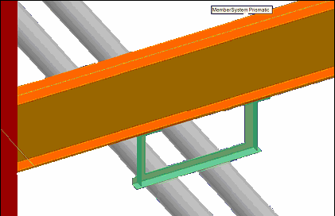

Place Support by Structure (Standard)
places a support at the intersection of the selected supported feature (or features) and a vertical plane passing through the selected supporting structure
Lab 1

Slide 6
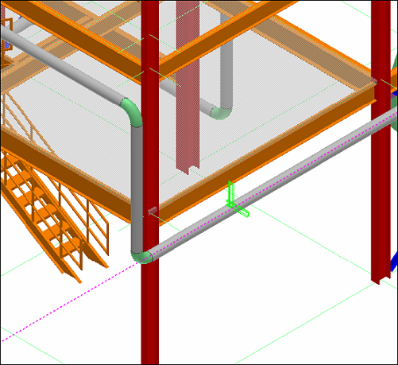
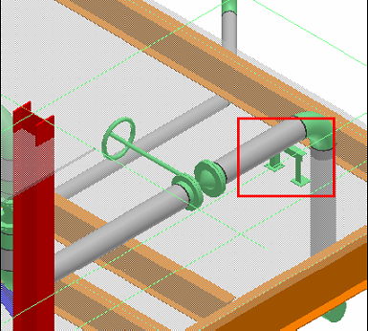
Place Support by Point (Standard)
Places a support for a feature at a specific point along the feature
A support on a feature running under/above a slab or a plate can connect to the structure/slab at any point along the feature
The plane selected on the supporting structure can be at any angle
Lab 2

Slide 7
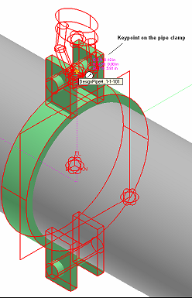
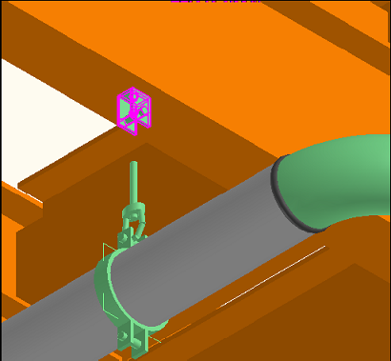
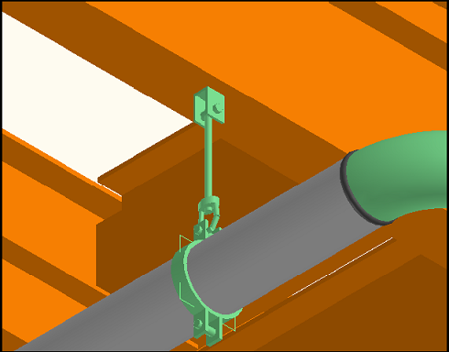
Place Support by Parts (Designed)
A designed support is a custom configuration of parts
First creates reference graphics at the identified logical support location instead of placing physical parts
Manually add support parts by using the Place Part command
Edit the position and the orientation of these parts using the Move and Rotate common commands
Labs 3-4

Slide 8
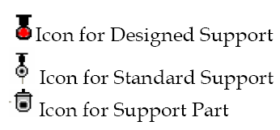
Drop Standard Support
Used to modify the individual parts of a standard support after placement
Users may convert a standard support to a designed support by using the Drop Standard command
This removes the control of the standard support over the parts so that they can be edited individually

Slide 9
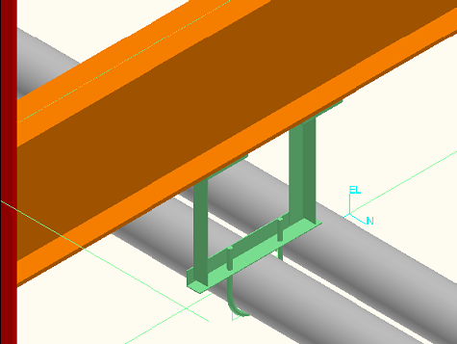
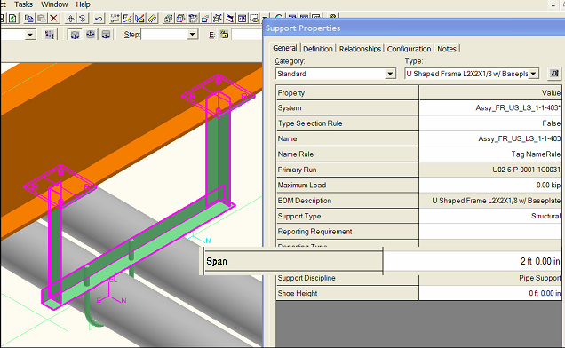
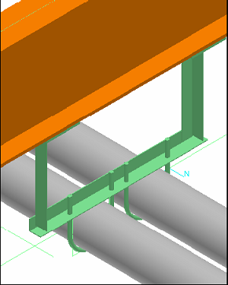
Add Supported Features to Support
More supported features can be added to existing supports
Lab 5

Slide 10
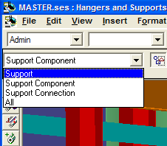
Delete Support and Parts
Use correct locate tool filter to select a component or a support for deletion
Remember that components from standard support assemblies cannot be deleted individually
Support components from designed supports can be deleted individually
Lab 6

Slide 11
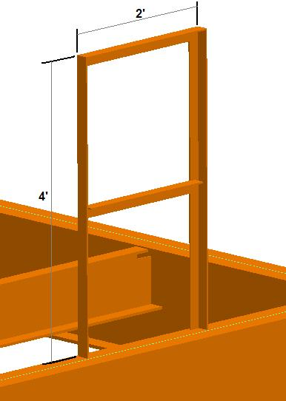
Place Linear Member
To place supporting steel modeled from structural steel shapes from the Supports Catalog
Can design fully detailed custom structural frames using structural members
Steel members placed this way are reportable as structural steel, NOT support components
Use Place Part command to add light steel
members to a support assembly, this will
cause the steel member to be reported as
support components in the BOM

Slide 12
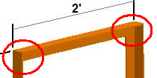
Place Assembly Connection
Details the connections between linear members by trimming the members and adding connection parts as needed
Labs 7-8

Slide 13
Editing Support Data Tips
Modify properties: Edit the reporting and other management properties of both the standard and designed supports. Can edit the dimensions of standard supports. Can edit the individual properties of parts within designed supports
Select different inputs: Can modify supports by selecting a different supported route feature, or a different supporting structure
Move: Can move a support positioned by point
Copy: Can copy a standard and designed support, and support parts to a different location
Delete: Can delete standard and designed supports. Cannot delete a component from a standard support because the parts are controlled by the standard support assembly. Use the Drop Standard Support command to break a standard assembly into editable parts

Slide 14

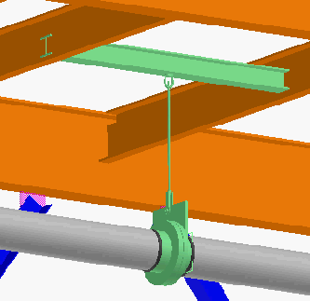
Copy/Paste w/Clipboard
Demo
  Copy to clipboard
  Paste from clipboard
  Assembly is temporarily available for pasting until something else is stored in the clipboard

Slide 15

Copy/Paste w/Catalog
Demo
  Copy to Catalog for future re-use by anyone in the project
  Paste from Catalog support assemblies saved by you or other users in the project

Slide 16

Basic Supports Ortho Creation I
  Taken from procedure for Cliffside project using SP3D Version 7 Service Pack 3
  Projects using V7 SP5 and above have access to Tools>Drawing Console to simplify process
  Lab

Slide 17

Basic Supports Ortho Creation II
  Touching up/post processing support ortho
Lab

Slide 18

Basic Supports Ortho Creation III
  Support orthos by volume
  Procedure is used when further manipulation of the drawing volume is needed to incorporate graphics the drawing by query manager ignores
Lab

